Slide 1
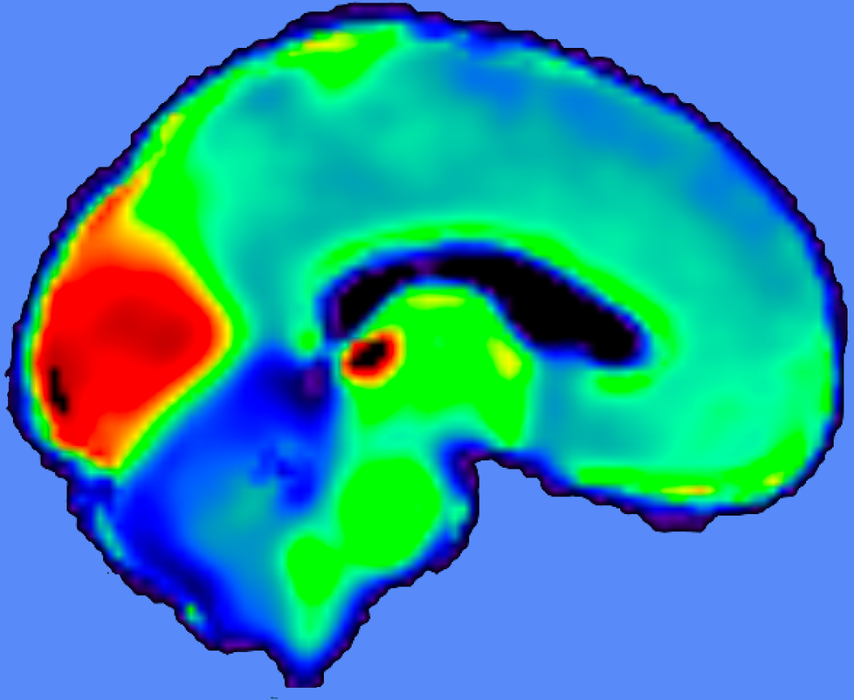
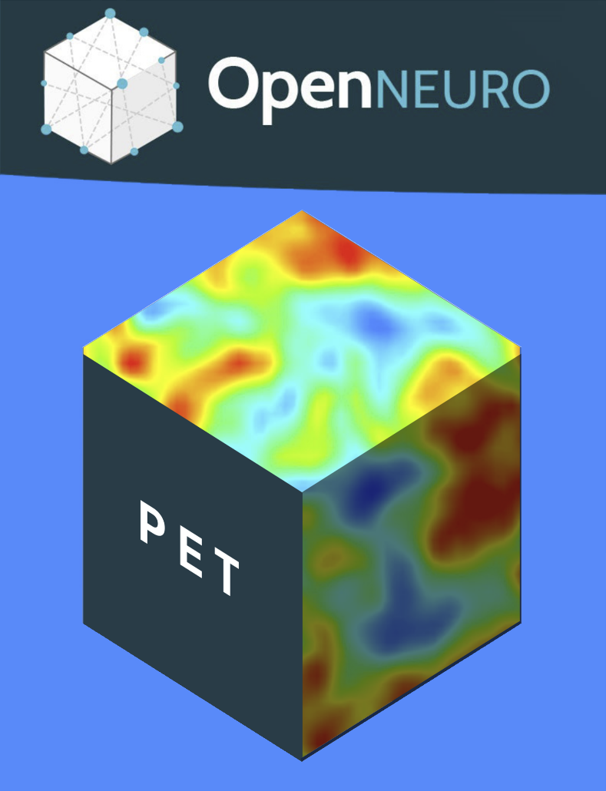
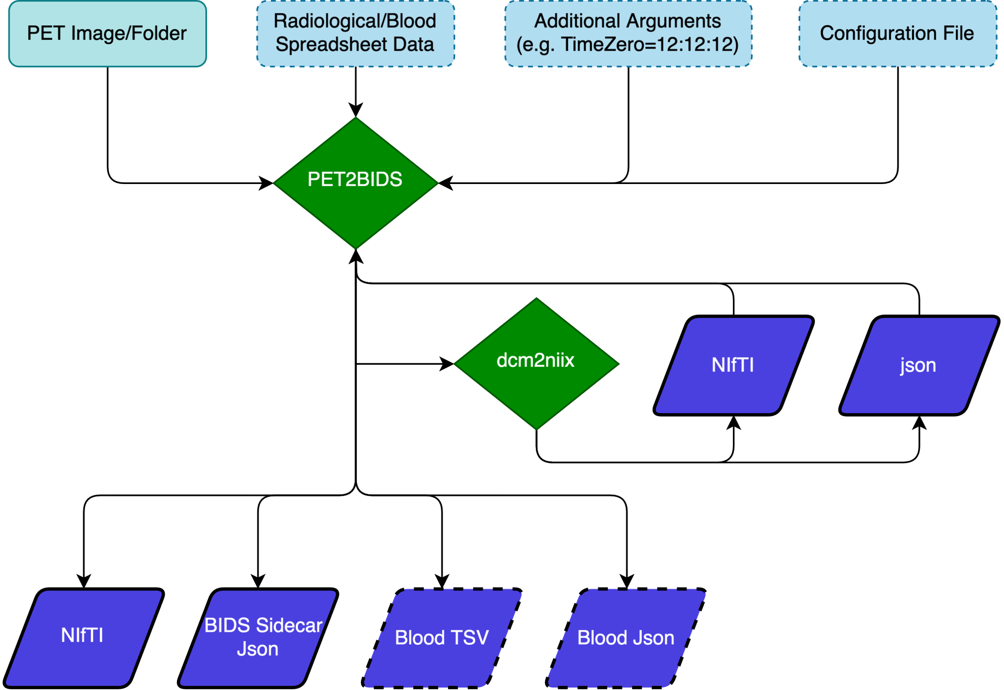


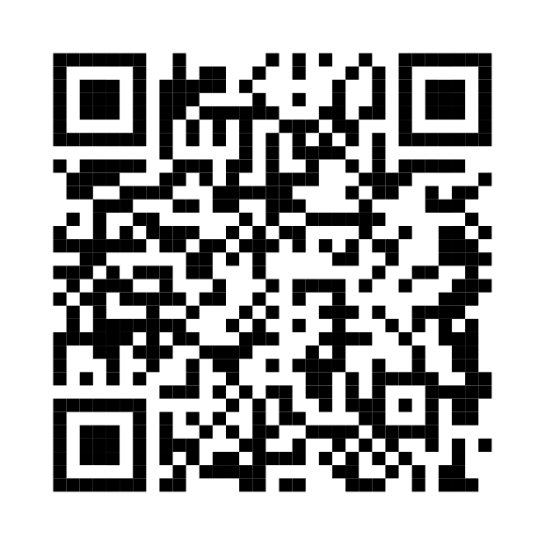
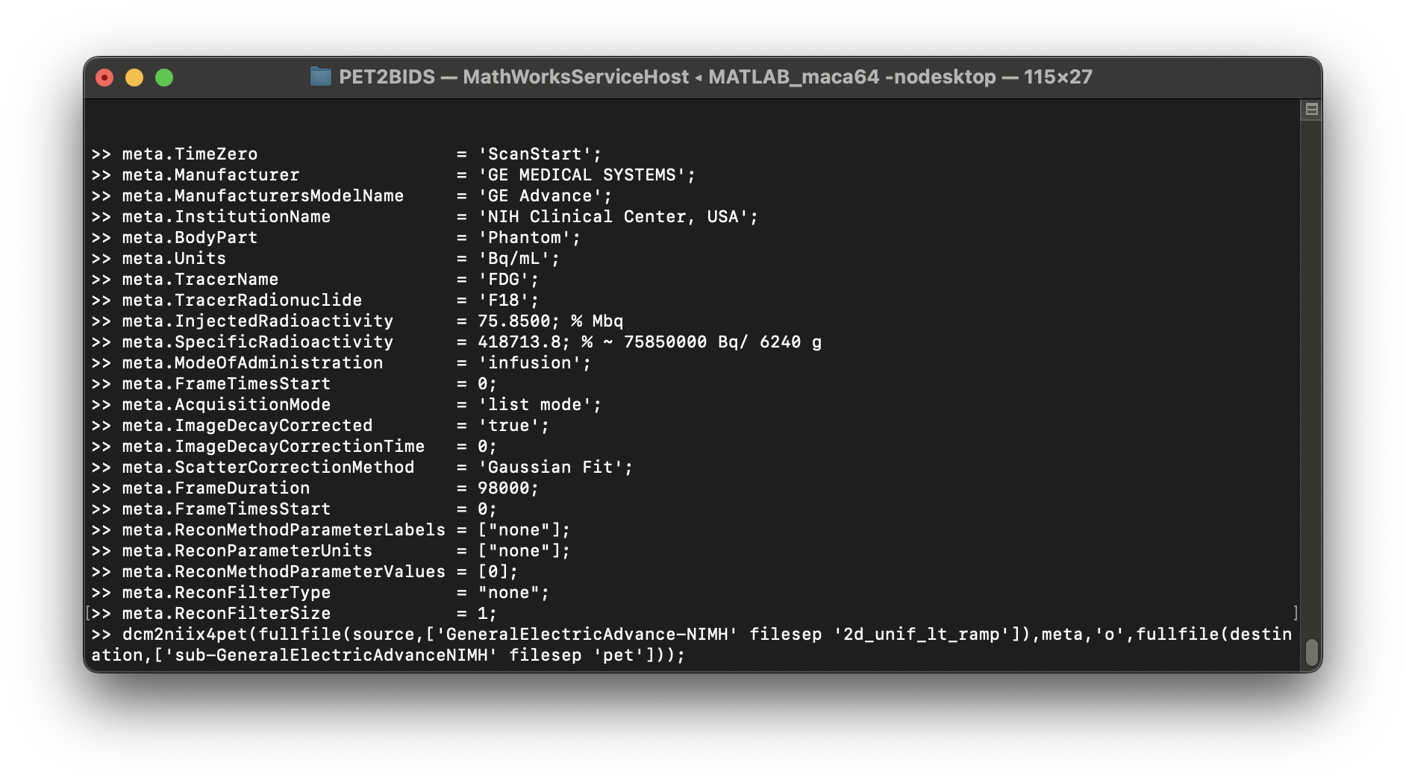
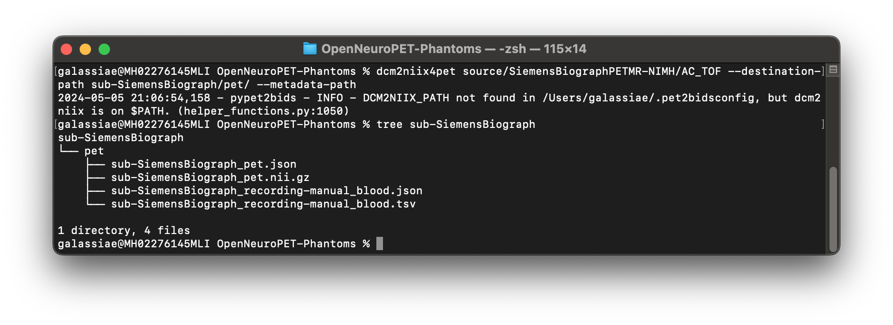
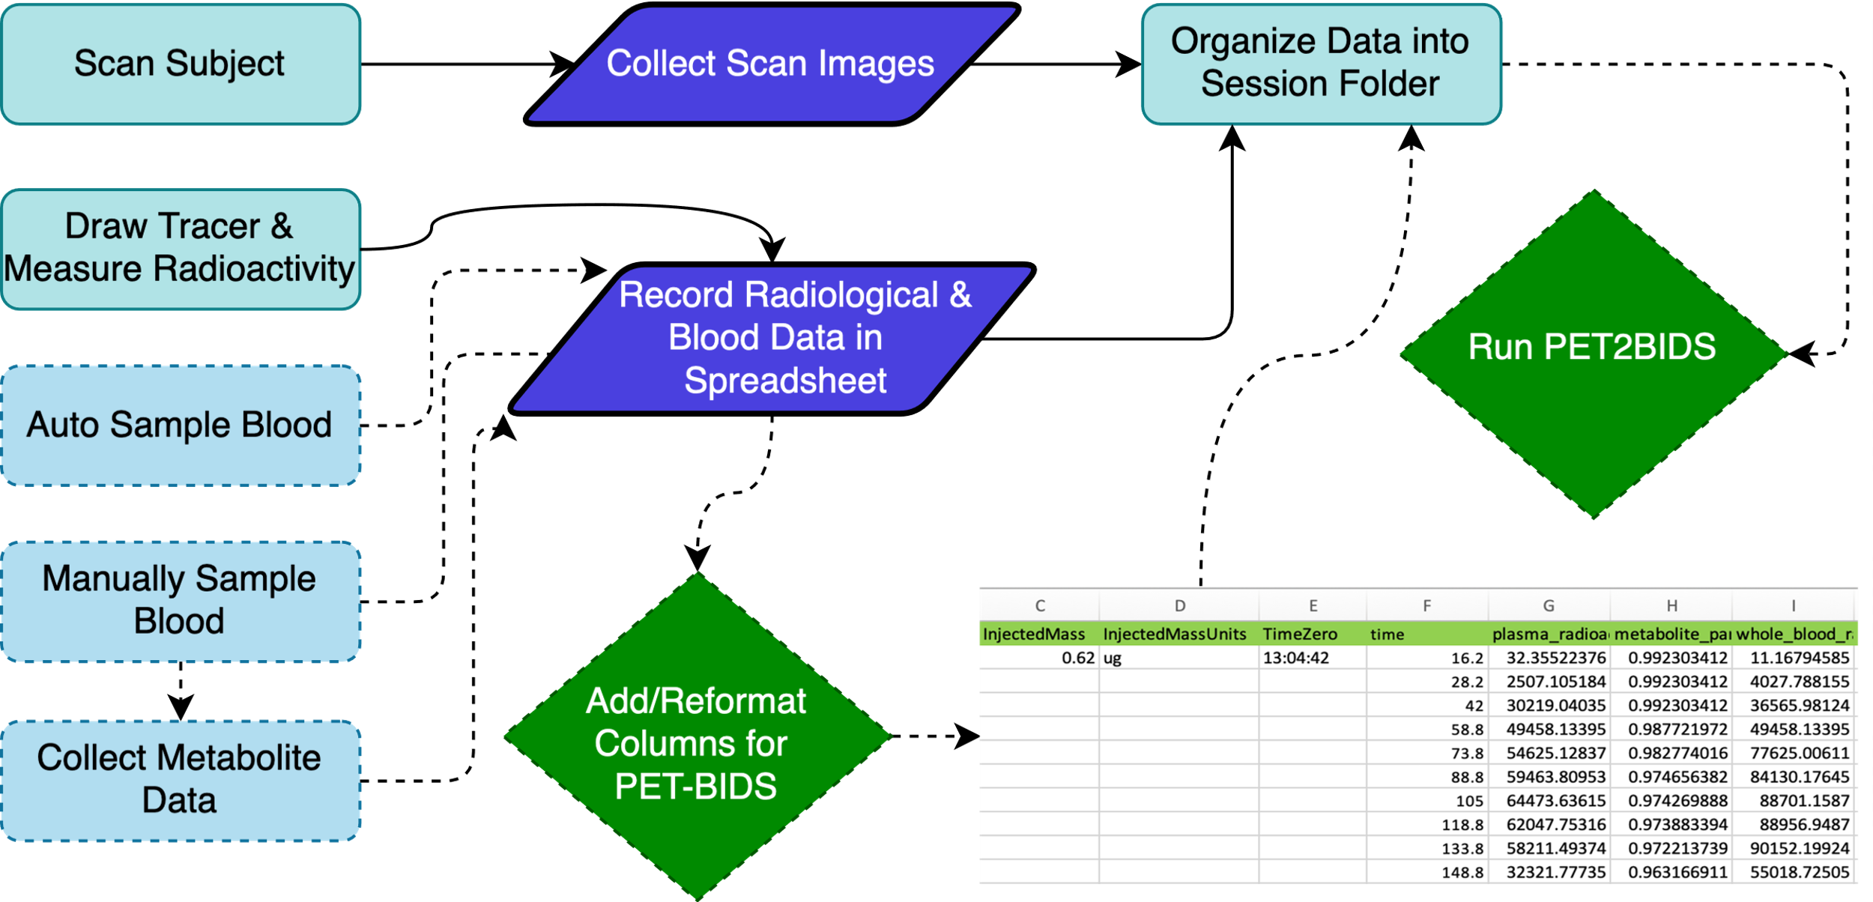





PET2BIDS: a library for converting positron emission tomography data into the Brain Imaging Data Structure
Anthony Galassi 1 , Martin Norgaard 3,4,5 , Adam G. Thomas 1 , Gabriel Gonzalez-Escamilla 6 , Claus Svarer 3 , Chris Rorden 7 , Granville J. Matheson 8,9 , Gitte M. Knudsen 3 , Robert B. Innis 1 , Melanie Ganz 3,4 , Cyrus Eierud 2 , Murat Bilgel 10 , and Cyril Pernet 3
1 National Institutes of Health, USA 2 TReNDS Center, Georgia State University, USA 3 Neurobiology Research Unit, Rigshospitalet, Denmark 4 Department of Computer Science, University of Copenhagen, Denmark 5 Department of Psychology, Stanford University, USA 6 University Medical Center of the Johannes Gutenberg University Mainz, Germany 7 Department of Psychology, University of South Carolina, USA 8 Mailman school of Public Health, Columbia University, New York, USA 9 Department of Clinical Neuroscience, Karolinska Institutet and Stockholm County Council, Sweden 10 National Institute on Aging Intramural Research Program, USA
Introduction and Motivation
Usage
The Brain Imaging Data Structure [BIDS 1] defines a curated framework that allows automated, reproducible and transparent analysis for neuroimaging studies. BIDS has already become popular in the magnetic resonance community with adoption by major brain imaging repositories (e.g., CONP, OpenNeuro, WeBrain) and data processing pipelines [2]. The recent extension [3] of BIDS to support positron emission tomography (PET) studies has created a need for a conversion tool for this modality.
Our goals were to create a software library capable of shaping PET data into BIDS that:
Supports researchers and data curators by accepting PET imaging (DICOM, ECAT) and spreadsheet (csv, tsv, and xlsx) data as input.
Can be integrated into existing tools to extend their conversion capabilities to include PET BIDS.
While BIDS conversion can be tedious the benefits of a standardized data structure make the effort worthwhile. By converting PET data into BIDS users are more easily able to work at the study level instead of the subject level, quickly perform QC, improve reproducibility, and more easily move forward in meet data sharing requirements. PET2BIDs aims to make the PET conversion process as simple as possible so that users can realize the benefits that a standardized data structure provides.
Read more about usage via the QR code above
Converting PET data to BIDS unlocks a rich and growing set of tools created for the analysis, modeling, and sharing of PET data.
Fig. 2 PET2BIDS collects PET imaging data and additional metadata via spreadsheet, extra arguments, and/or a configuration file. After PET2BIDS coverts the input images into NIfTI and json it collects those outputs and either annotates or updates the json with PET-BIDS fields based on all user provided inputs. Then the NIfTI and json file are renamed and placed at the specified output directory. If blood information is provided PET2BIDS will produce the corresponding output in BIDS form as a *_blood.tsv and *_blood.json file.
Conversion takes place at the command line or within a Matlab IDE. Users have the final say as to what the values of the converted output should be and multiple methods of providing those values. Output data can be modified with either any or all the following: a spreadsheet file, individual arguments, or (for static values) a configuration file.
Methods
PET2BIDS converts imaging data to NIfTI format with the aid of dcm2niix[5], Nibabel[6], and readECAT7.m[7]. Since raw PET images do not contain all the metadata required for reproducibility, PET2BIDS collects PET-BIDS metadata from both the image headers as well as user supplied inputs (e.g. spreadsheets and command line arguments). This provides a comprehensive and easy to use solution for PET users to exploit the benefits of BIDS.
The PET community uses a variety of tabular data formats to (a) keep track of radiotracer information injected per participant and (b) record time and radiotracer concentration from blood sampling. Our tool includes dedicated functions that can convert these files to the JSON and TSV formats detailed in the PET-BIDS specification. For example, the tool can convert a tabular PMOD (https://pmod.com) file to the blood.tsv file required by PET-BIDS.
Additional tooling was written to determine if raw files are PET files, collect and store unchanging PET hardware data (scanner, gamma counter, or HPLC unit information), as well options to assist installation for unprivileged users on institutionally controlled hardware.
Significant testing was performed on both phantom and real data collected from a multitude of different scanners, manufacturers and sites.
c
Fig. 3 An invocation of dcm2niix4pet from an interactive Matlab command window with all required PET data absent from the imaging data supplied via a struct.
PET2BIDS Integrates into Existing Workflows
Fig. 4 A Python version of dcm2niix4pet along with the output PET-BIDS files including blood data. When sufficient data is available pypet2bids will produce the associated BIDS blood files for the session automatically.
Results
PET2BIDS provides users and developers multiple avenues to convert their PET data into BIDS.
PET2BIDS is easily distributed as either a Matlab or Python tool for both end users and tool developers via GitHub or the Python Package Index (PyPi.org)
PET2BIDS has been used to convert several datasets now shared on OpenNeuro and as much or many more currently unshared PET datasets.
Python tool developers can add PET-BIDS support to their existing conversion
tools using the pypet2bids library. E.g., one can PET data to BIDS with zero
setup by visiting brainlife.io/ezbids [8] or scan the QR code to the right view
a conversion.
Fig. 1 In a typical workflow for a PET experiment radiological and other data are collected and stored into a spreadsheet(s). Optionally, one can format this spreadsheet (or an additional sheet w/ in) to align with BIDS entities. This formatted spreadsheet can later be included along with the imaging data and passed to PET2BIDS to be converted. After which, PET2BIDS will extract BIDS labeled columns and include them in the final BIDS output. This method of providing input is easily auditable and more intuitive to users not familiar with the command line.
Contact: anthony.galassi@nih.gov
View the PET2BIDS Repository
References
1. Gorgolewski KJ, et al. (2016). Scientific Data, 3(1), 1-9
2. Gorgolewski KJ, et al. (2017). PLoS computational biology, 13(3), e1005209.
3. Norgaard M, et al. (2021). Scientific data, 9(1), 65.
4. Knudsen GM, et al. (2020). Journal of Cerebral Blood Flow & Metabolism 40.8 (2020): 1576-1585.
5. Li X, et al. (2016). Journal of neuroscience methods, 264, 47-56.
6. Brett, M, et al. (2020). nipy/nibabel: 3.2. 1. Zenodo.
7. BT Christian (1998), RF Muzic (2002), readECAT7.m
8. Levitas D, et al. (2024). Scientific data, 11(1), 179.
9. Ard, T., et. al. (2022) Scientific Data, 9(1), 298.

